Slide 1
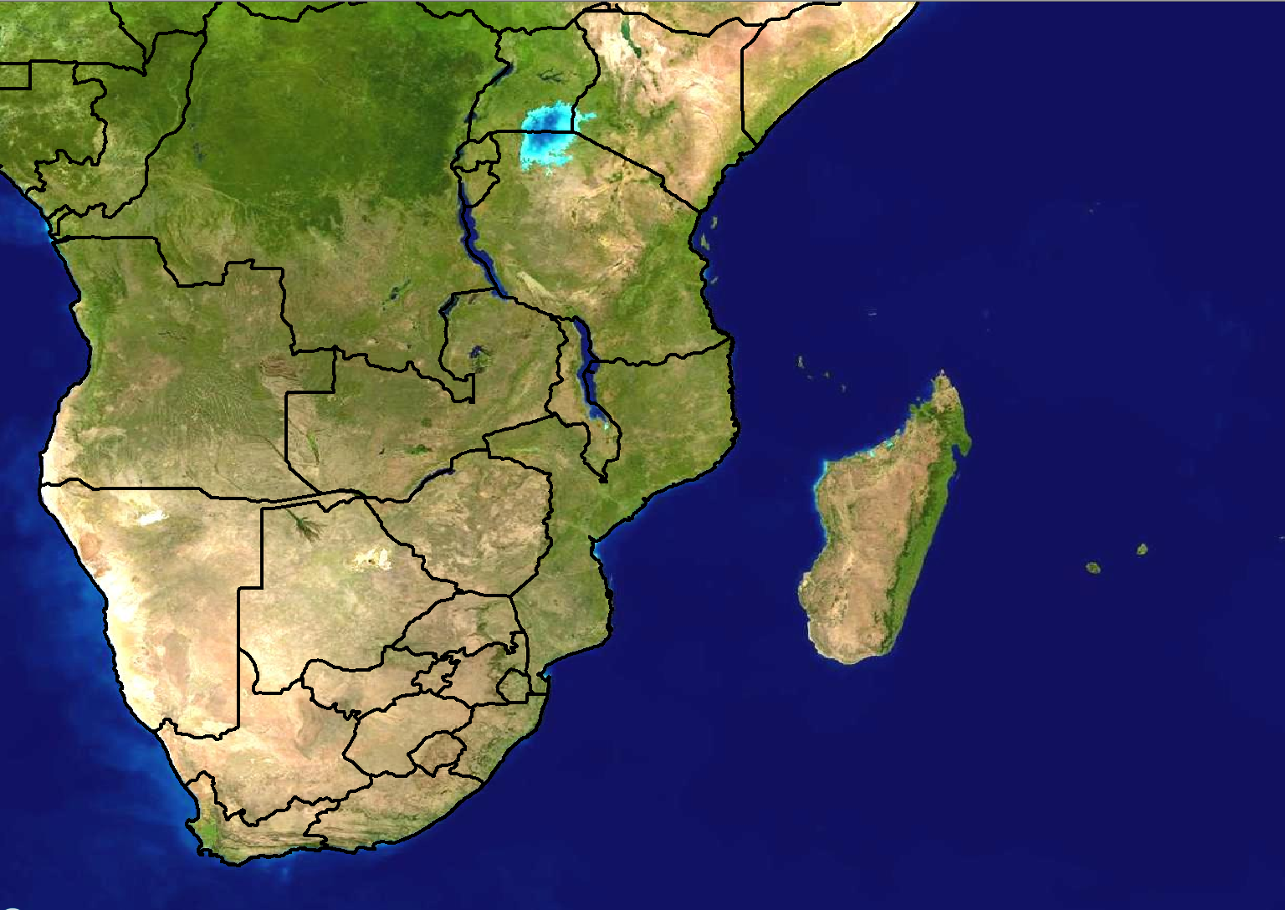
Scenario 1: Forecast for Day 3
24 hour rainfall (mm)
>100
80-100
60-80
40-60
20-40
Forecast issued:
Monday 20 February
Forecast valid:
Wednesday 23 February

Slide 2
Scenario 1 - Additional information:
The ensembles indicate a very large area where 20-40mm is expected in a 24 hour period. A small area of 60-80mm is expected over the central parts of the Democratic Republic of Congo (DRC) for day 3, Wednesday.
It needs to be noted that the models are showing 40-50mm of rainfall over the south-eastern parts of the DRC for tomorrow (Tuesday).

Slide 3
Scenario 2: Forecast for Day 1 (Today)
24 hour rainfall (mm)
>100
80-100
60-80
40-60
20-40
Forecast issued:
Wednesday 23 February Forecast valid:
Wednesday 23 February

Slide 4
Scenario 2 - Additional information:
An MCC developed overnight around the Kinshasa area, resulting in 60mm being reported at Kinshasa.
Models are in agreement with rainfall amounts of >80mm in 24 hours over the western parts of DRC
The Unified Model (12km) shows 6 hourly rainfall amounts of 30-40mm between 12-18Z while Aladin shows the 60-70mm of rainfall over that area.
It looks as though the MCC could re-develop this evening
A dignitary from Angola is expected to arrive at Kinshasa Airport this evening and the Air traffic controllers are concerned about the runway having too much water on it already.

